Slide 1
Malware Analysis
Dr. Tran The Son
Vietnam – Korea University

Slide 2
Surface Analysis
Scanning
  www.virustotal.com
Packed or Obfuscated
  PEiD
String contained
  Strings
Hashing check
  md5deep /HashCal
PE header analysis
  PEView

Slide 3
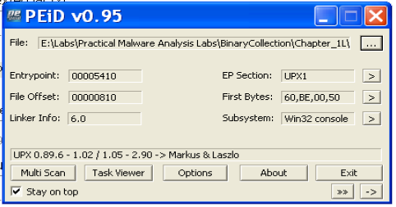
PEiD
Input File
Section View
PE Disassembler
PE Details
Plug-in
Scan folder

Slide 4
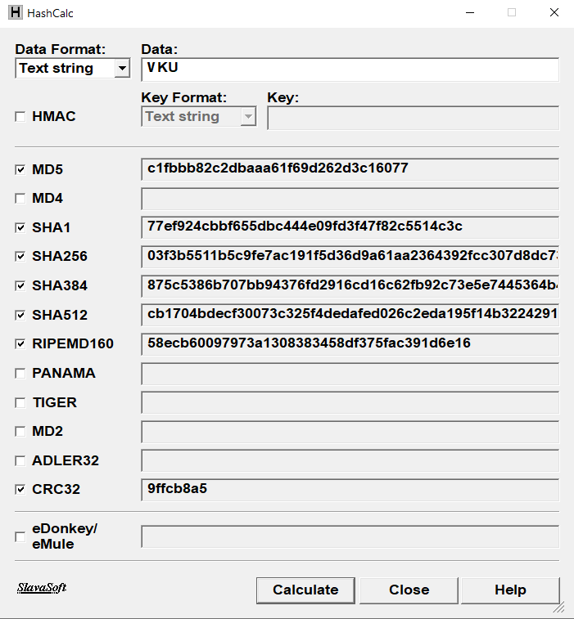
HashCalc

Slide 5
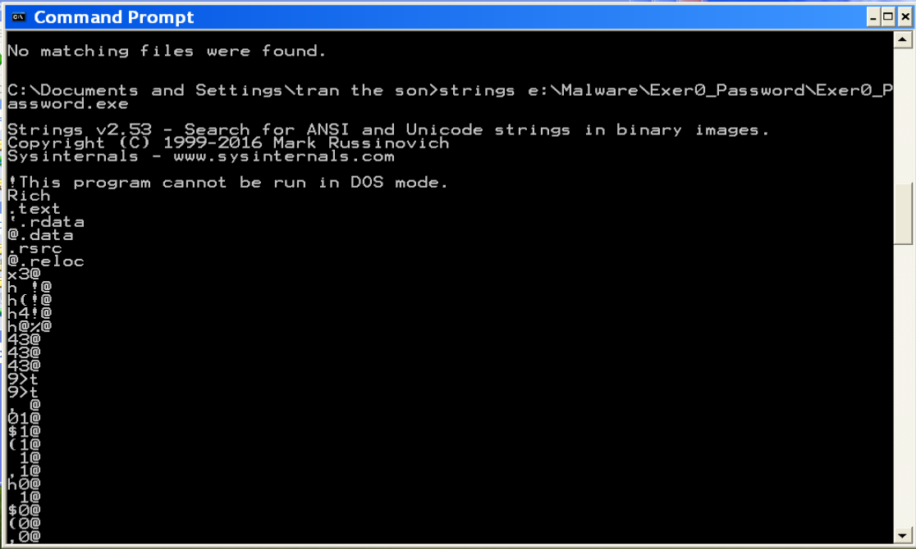
Strings

Slide 6
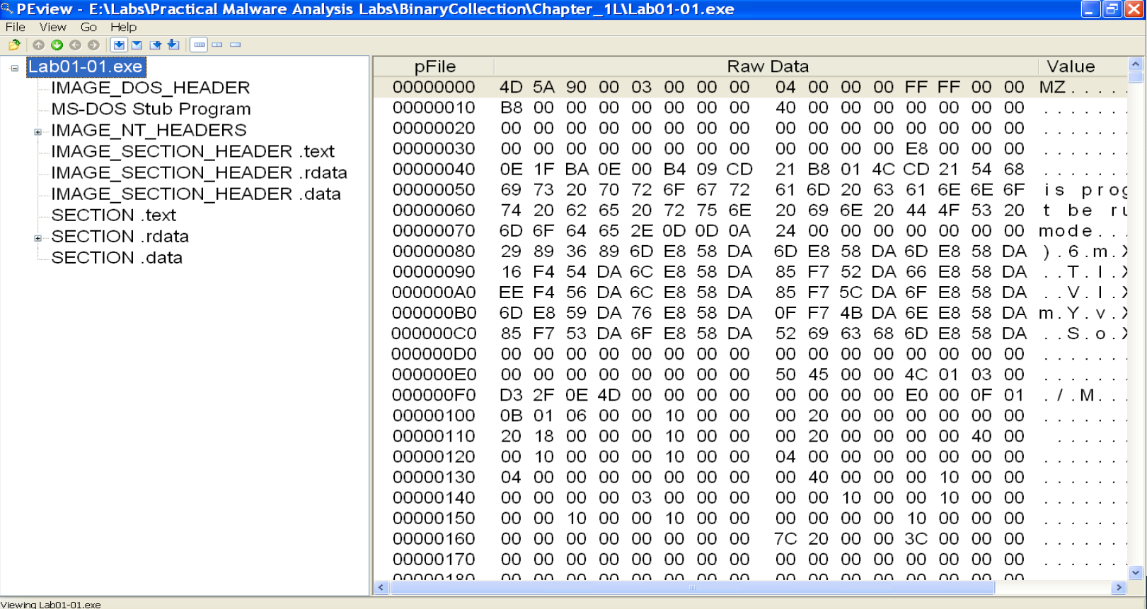
PE View

Slide 7
Practice 1 [Surface Analysis]
File: Lab01-01.exe, Lab01-01.dll; Lab01-04.exe
Tools
  VirusTotal
  PEview
  PeiD
  String
  HashCal
Questions
  Packed or obfuscated?
  Check it on Virustotal: match any existing antivirus signatures?
  When was it compiled?
  Imports
  Strings
  Hash No.?
  Host-based indicators &
  Network-based indicators
Guess the purpose
of the PE file

Slide 8
Practice 2 [Pack & Unpack]
  PE File: Lab01-02.exe; Lab01-03.exe
  Questions
    Check it on VirusTotal.com: match or not?
    Compare the Strings differences before/after unpacking?
    Check Imports?
    Host-based indicators?
    Network-based indicators?

Slide 9
Project idea
Write a piece of code to detect and display strings of a PE file.
Write a piece of code to generate a hash code (MD-5, SHA-x) for a:
  Word/String/Sentence/File
Write a simple PEView program
  https://docs.microsoft.com/en-us/previous-versions/ms809762(v=msdn.10)
  https://github.com/quangngoc430/PeFile-View

